Slide 1
STLC Flow for Laptop Product
Software Testing Life Cycle with Explanation
GROUP-5

Slide 2
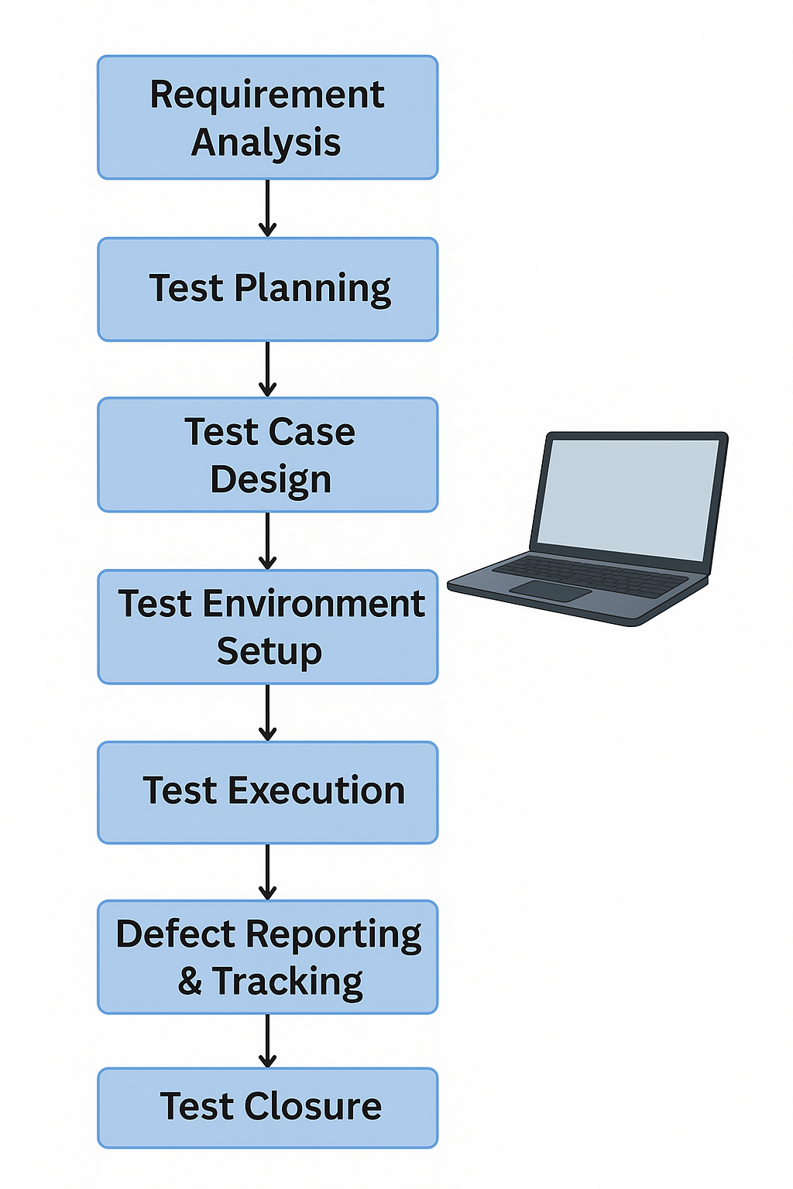
STLC Flowchart for Laptop Product

Slide 3
Requirement Analysis
Understand hardware and software features like boot performance, ports, battery life, etc.
Objective: Understand what features, specifications, and software components the laptop must have.
Activities:Analyze system requirements: OS type, pre-installed apps, firmware, drivers.Understand target users: gamers, students, professionals.Identify testable and non-testable requirements.Review compliance (e.g., Windows 11 compatibility, security features).Deliverables:Requirements Traceability Matrix (RTM)Feasibility report

Slide 4
Test Planning
Prepare strategy including functional, non-functional, and compatibility testing.
Objective: Define the scope, strategy, and resources for testing.
Activities : Determine testing objectives (e.g., performance, usability, compatibility).Estimate time and cost . Define roles and responsibilities . Choose tools for automation and reporting (e.g., Selenium for UI testing, JIRA for issue tracking).
Deliverables : Test Strategy Document Test Plan Document

Slide 5
Test Case Design
Design test cases for verifying ports, power button, system boot, display, and battery.
Objective: Create test cases to validate laptop functions.
Activities:Write test cases for OS boot-up, Wi-Fi connectivity, audio/video playback, app installation, etc.Define expected results.Create positive and negative test cases.
Deliverables:Test cases and test scriptsTest data

Slide 6
Test Environment Setup
Setup different configurations and simulate power conditions.
Objective: Set up hardware and software environments where tests will be run.
Activities:Configure different laptop models.Install various OS versions (Windows 11, Linux distros if multi-boot).Set up peripherals (printers, external monitors, USB devices).
Deliverables:Environment setup documentSmoke test report

Slide 7
Test Execution
Run test cases, check system behavior under stress, and log results.
Objective: Execute test cases and report bugs.
Activities:Perform functional, performance, and regression testing.Log defects in a defect tracking tool.Track pass/fail status.
Deliverables:Test execution reportDefect report

Slide 8
Defect Reporting & Tracking
Report bugs using tools like Jira, prioritize them, and ensure retesting.

Slide 9
Test Closure
Document summary report, lessons learned, and ensure quality compliance.
Objective: Evaluate the testing process and results.
Activities:Assess test coverage and defect density.Document lessons learned.Archive test artifacts.
Deliverables:Test closure report

